Slide 1

A Sometimes Odd Couple
The importance of having a healthy and open dynamic between Procurement and Accounts Payables to achieve your institution’s overall goals

Slide 2

Procure-to-Pay
The Procure to Pay process is very much like grocery shopping. Someone picks out the items and someone has to pay for them.
It’s a relationship, between two functional groups with slightly different objectives, that when healthy can create areas of growth and efficiencies at your institution.
“Without AP, Procurement is just stealing”- Paul Fitts, former CPO UT Tyler.

Slide 3

Procure-to-Pay
An unhealthy relationship between the two areas can create chaos and can stymie an institution across all areas.
This Photo by Unknown Author is licensed under CC BY-SA-NC

Slide 4
Foster a Healthy and Dynamic Relationship
Regular Meetings
  Standing meetings weekly
  Sometimes the talk isn’t business-related: Get to know each other as people, not just co-workers
Understanding of each other’s requirements and needs
  Know enough to be dangerous but smart enough to ask questions
  Don’t pretend to be an expert in the other area, but have awareness of:
    Statutory requirements and limitations on the other group
    Pain points for the other group, and what you can do to ease their pain (opportunities for process efficiencies!)
Benefits
  Collaborative model to help gain efficiencies and compliance
  Being able to be more flexible as conditions change
  A more enjoyable work environment: The two units work together to work through issues faster as the leadership relationship trickles down to the staff

Slide 5
Collaboration at UTA
PaymentWorks
Supplier setup was manual and required involvement of multiple groups
  Time-consuming and open to human error
  Supplier inputs information and manages any changes. Fraud protection (especially banking changes)
  Increased transparency into overall onboarding process across the institution
  Increased transparency into supplier status within the process
Manual checking of Federal debarment lists and State of Texas Divestment Lists
Automated within PaymentWorks and suppliers flagged for if they appear on any list

Slide 6
Collaboration at UTA
Jaggaer
Payables not involved in original planning, transitioning from primarily ProCard payments to voucher payments with no input from Payables. Bad idea.
Procurement tool, but most issues were on the payables/invoicing side
    Allowed for transitioning of over $600K of un-managed/rogue spend monthly to contracted vendors, and 80% of that is with HUB vendors
    Most issues related to suppliers not submitting invoices through Jaggaer (we have no insight)
    Now monitoring PO’s that have no invoice after 30 days
    Increased audit compliance

Slide 7
Collaboration at UTA
HUB Program Office
(HSP Routing, Review and Approvals)
Unique to Texas public institutions, but still a good example and you may have something similar in your State where this would apply (e.g. a process that requires multiple reviews across multiple functional groups related to a PO or payment).
Manual entry of HUB language on PO by Procurement
AP had to go look at a PO to confirm PAR or No PAR requirement
Multiple emails between AP, HUB office, department, supplier, etc…

Slide 8
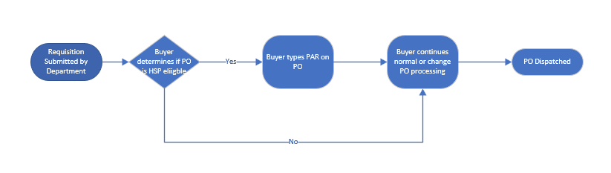
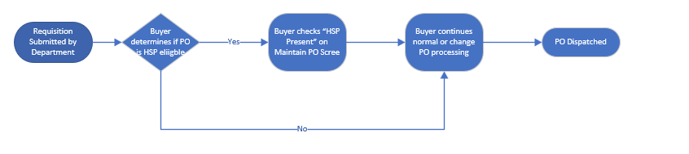
After - PO
Before - PO
Little change on the Buyer side, though it does reduce cutting and pasting of language and information “on” the PO.

Slide 9
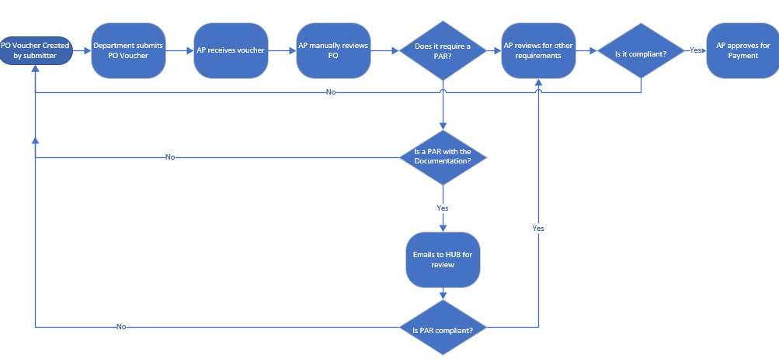
Before Voucher
PAR requirement identification and review done manually outside of Peoplesoft (emails).

Slide 10
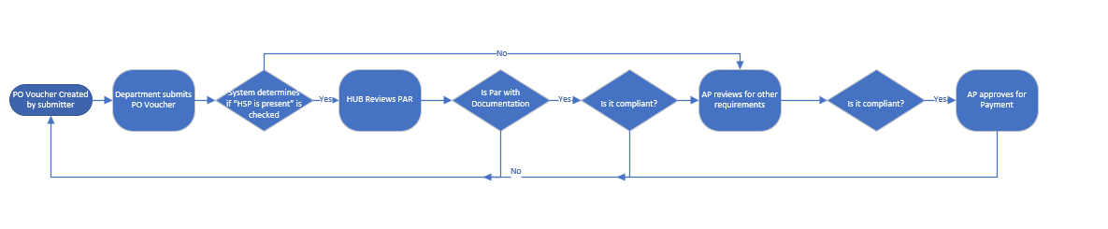
After Voucher
PAR identification is automated, and reviews/approvals are done within Peoplesoft workflow.

Slide 11
Questions?

