Slide 1
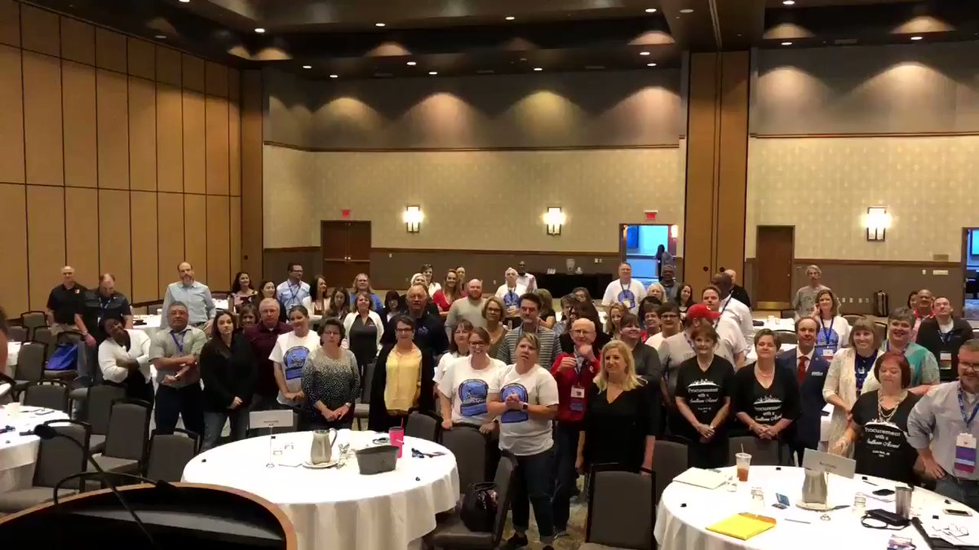
2018 TOAL
Closing General Session

Slide 2
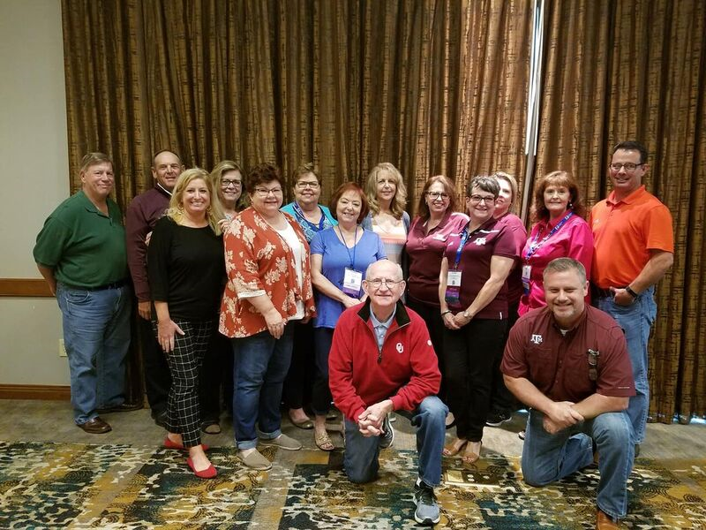
2018 TOAL Board of Directors & Past Presidents

Slide 3
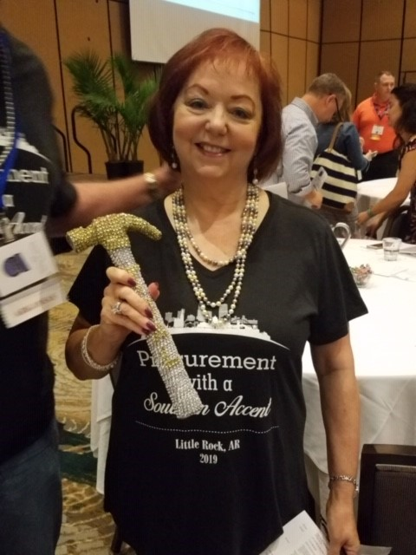
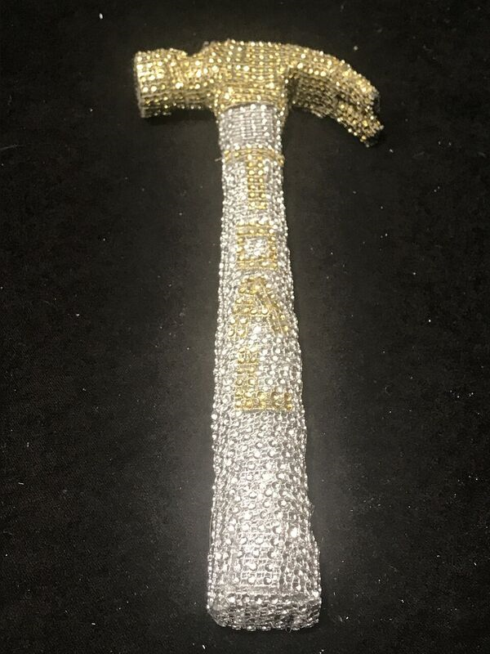
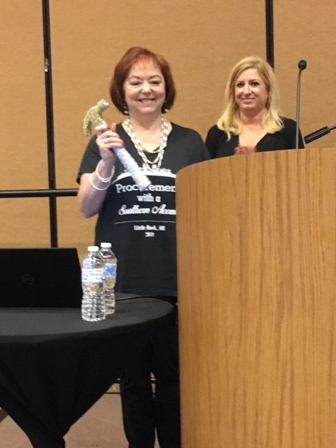
2018/2019 TOAL President
Suzanne Leslie
University of Arkansas for Medical Sciences

Slide 4
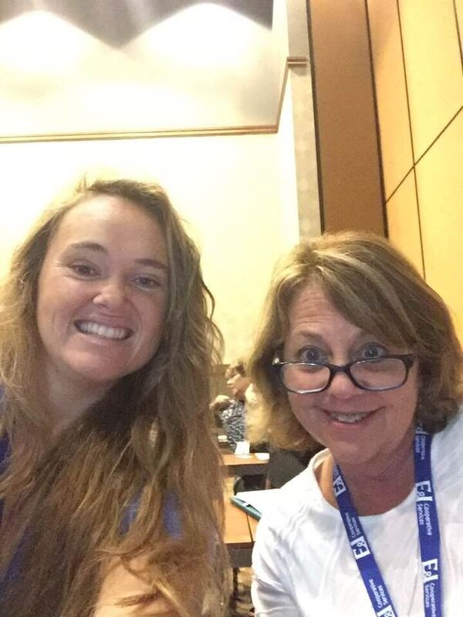
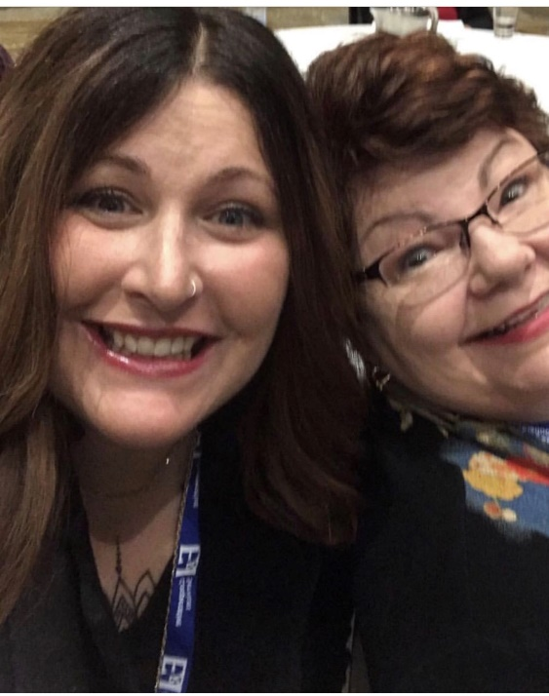
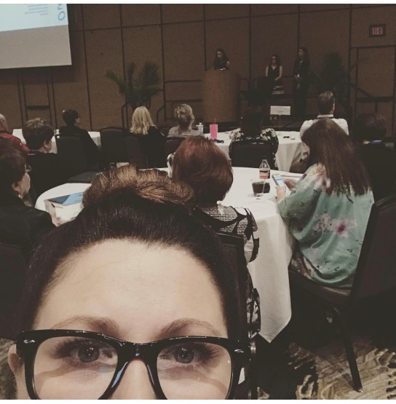
#TOAL2018 Selfies

Slide 5
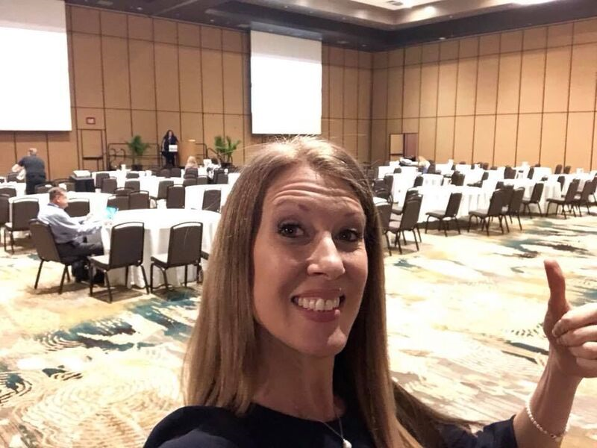
Betsy Allen Manning Opening General Session Keynote Speaker
#TOAL2018 Selfies

Slide 6
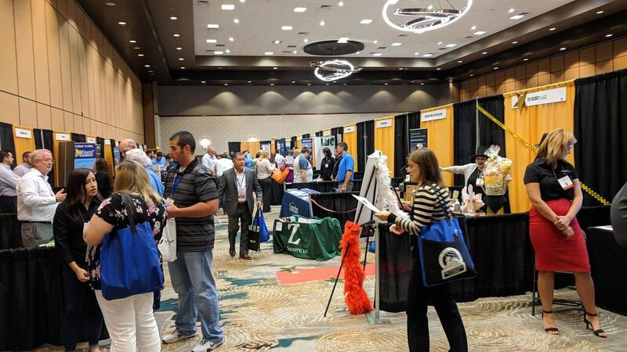
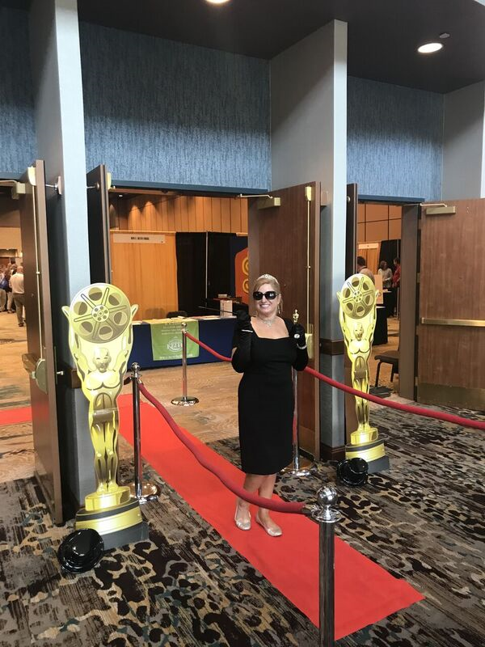
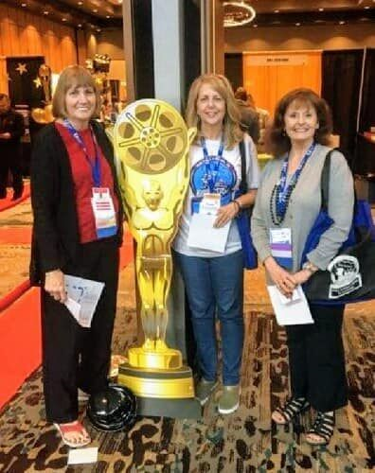
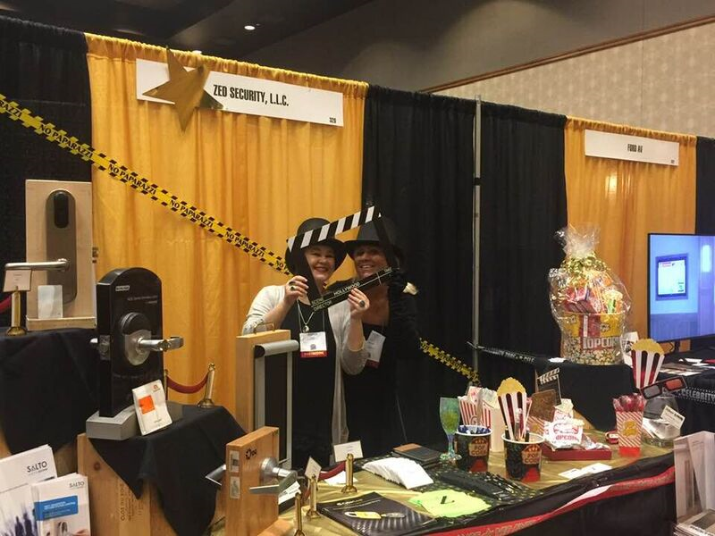
2018 TOAL Expo

Slide 7
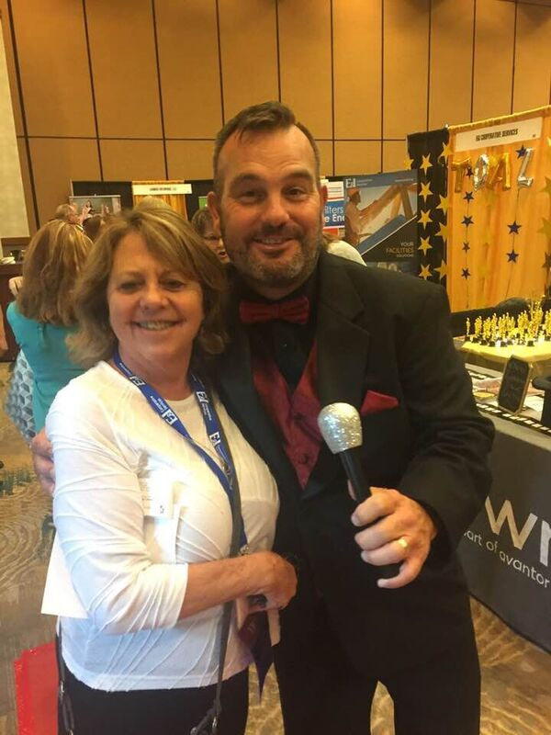
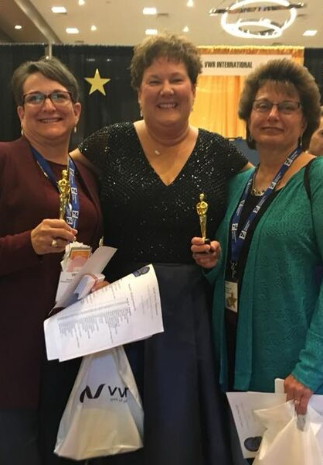
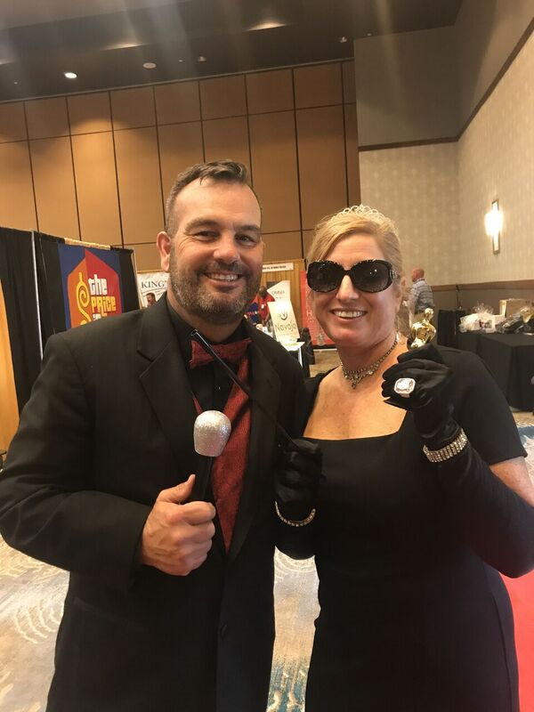
2018 TOAL Expo

Slide 8
2018 TOAL Expo
Texas A&M AgriLife team visits Dicki Murrell at the VWR booth

Slide 9
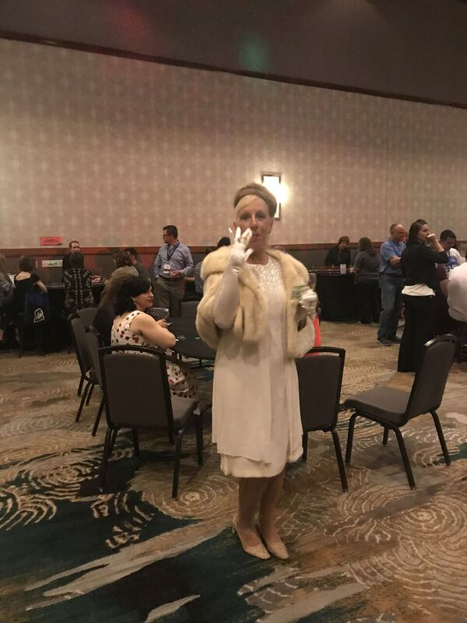
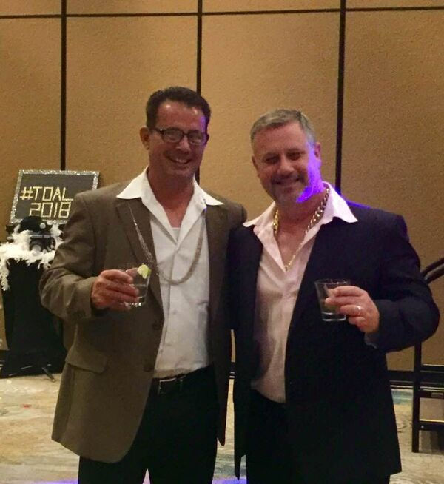
#Toal2018 sMILEs ☺
2018 TOAL Casino/Hollywood Night

Slide 10
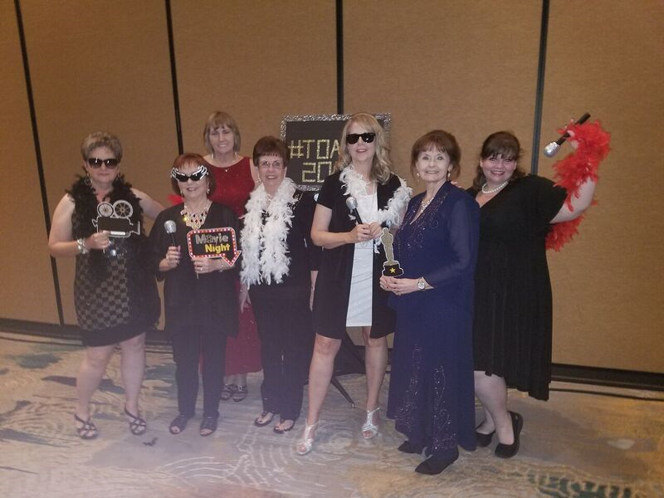
TOAL’s Arkansas friends take Hollywood!
2018 TOAL Casino/Hollywood Night

Slide 11
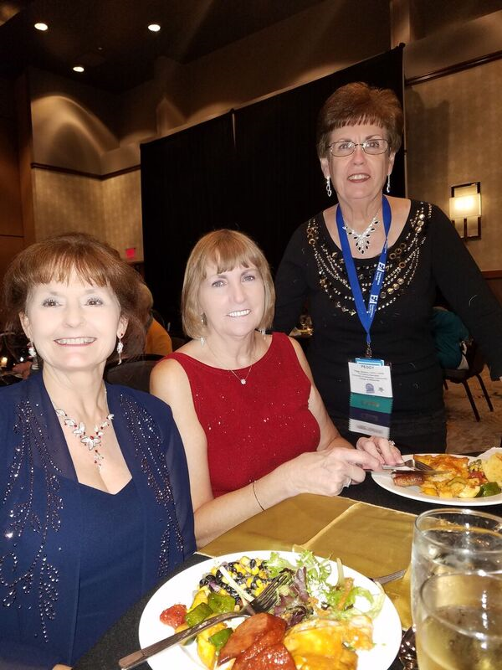
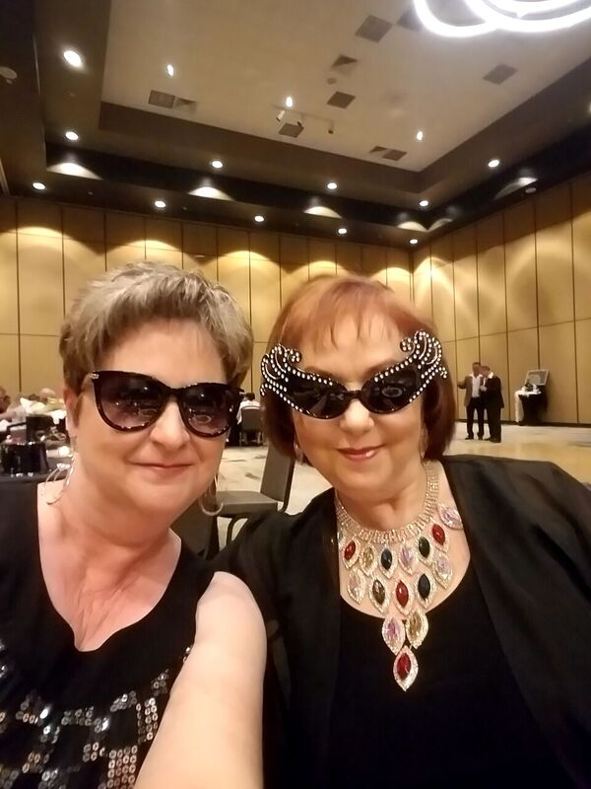
Our TOAL Arkansas friends take Hollywood
2018 TOAL Casino/Hollywood Night

Slide 12
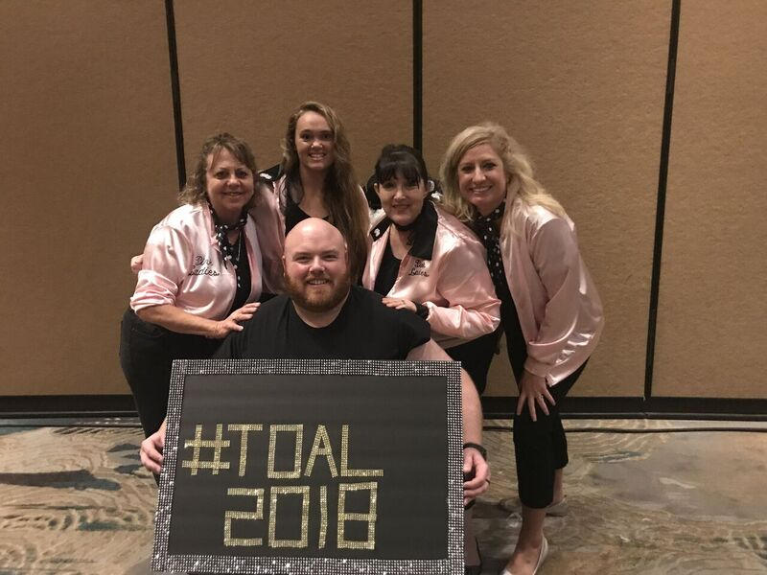
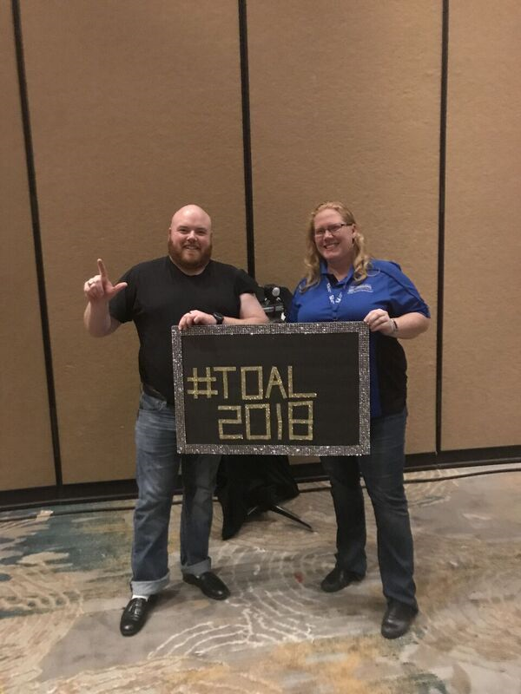
2018 TOAL Casino/Hollywood Night
#Toal2018 sMILEs ☺

Slide 13
